Slide 1




Data 604 Satistically modelling with data
Life Expectancy Analysis
Predict people’s life longevity
Presented by
Chenguang Sun - 30225609
Rookayat Adedo - 30181509
Olatomi Adigun - 30235750
Yutong Zhang - 30052929
Instructor: Quan long
Notes:
Hi everyone. My name is Olatomi and I am here with Michael, Olivia and Rukayat. Our presentation is on the Analysis of Factors that affect Life Expectancy

Slide 2




Agenda
1
Introduction & Dataset
2
Methodology and Data wrangling
3
Model Selection
4
Assumption & Conclusion
Notes:
This is the agenda for the presentation

Slide 3


Introduction
Definition of Life Expectancy: A statistical measure estimating the average age a person is expected to live (Ortiz-Ospina, 2017). Project Goals: Identify predictors of life expectancy. Conduct continental-scale life expectancy analysis. Determine the best predictor and forecast life expectancy Evaluate the impact of health, social and economic factors.
Why it's more than the mind
Why it's crucial
How to maintain positive mental health
When to seek professional help
Notes:
"I am sure if I were to take a poll in class now about aspirations, one of the top responses would be the desire to live a long and healthy life. This underscores the importance of our topic today.
Our project goals are
1. Identify predictors of life expectancy:
We aim to uncover the key factors that significantly influence life expectancy.
2. Conduct continental-scale life expectancy analysis:
Provide a perspective on life expectancy patterns as regards continent
3. Determine the best predictor and forecast life expectancy
4. Evaluate the impact of health, social, and economic factors

Slide 4

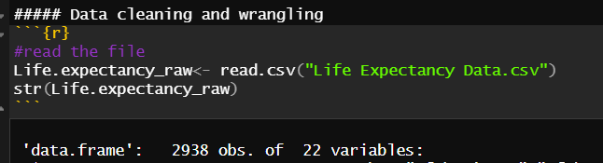
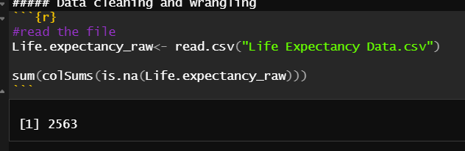
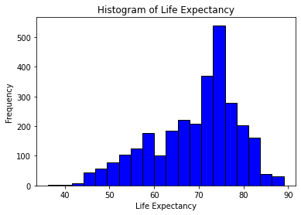
Dataset
Data Source
Open Data Source
Kaggle, Global Health Observatory (WHO), United Nations Website.
Scope
193 countries
Spans Years 2000 to 2015
Dataset Shape
2938 rows and 22 columns
Challenge
2563 null values
Notes:
"For our dataset. It is an open source one from Kaggle. The owner sourced and merged data from the Global Health Observatory under WHO, and the United Nations websites
The data covers 193 countries from 2000 to 2015, with 22 columns and 2938 rows.
For a challenge as regards the dataset, the dataset has 2563 null values. We will discuss how we handled the null values in Data Wrangling.

Slide 5
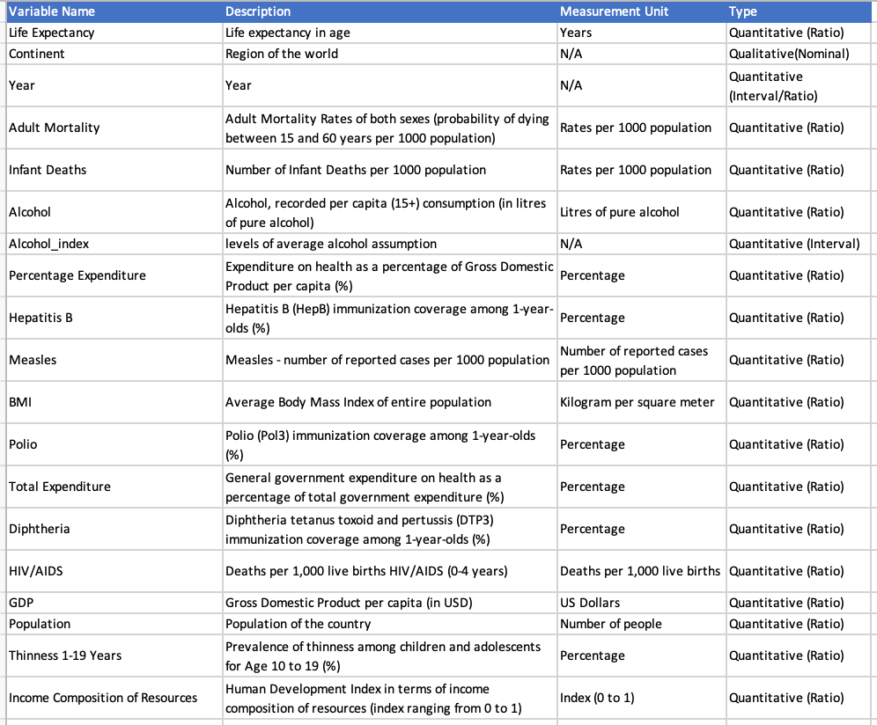
Variable Summary
Notes:
The majority of the data are quantitative, with Country and Status being the only qualitative variables. Our dataset encompasses both socio-economic and health factors. Social-economic factors include Population, Schooling, and GDP, while health factors comprise Adult Mortality, Polio, and HIV/AIDS.

Slide 6
Analysis Methodology
1
2
3
4
Data Wrangling
Model Selection
Regression Assumptions
Final Model Analysis
Removed missing values
Filled the rest missing values
Used different techniques and chose the final one based on performance
Interpretation of Final Model
Linearity, Independence, Normality, Equal Variance, Multicollinearity, Outliers
Notes:
We followed this guide in our analysis
Data Wrangling:
"We cleaned and prepared our raw data ensuring its suitability for analysis."
Model Selection:
Used different techniques and chose the final one based on different criteria
Regression Assumptions:
"To ensure we have a reliable model, assessed and validated the key assumptions underlying our regression model."
Final Model Analysis:
"Concluding our analysis, we applied the chosen model to the data, scrutinizing coefficients and evaluating model performance for meaningful insights

Slide 7
Two Models Explanation
Two Distinct Approaches for 'Year' Variable:
Numeric Approach: In the first model, 'Year' is treated as a numerical variable. This assumes a linear relationship between the year and the target variable (e.g., Life expectancy). It implies that changes in the target variable are consistent over time.
Categorical (Dummy) Approach: Division into Time Periods: Instead of individual years, the years from 2000 to 2015 are divided into three distinct periods. Each period represents a specific range of years. For instance, this could be early (2000-2005), middle (2006-2010), and late (2011-2015) periods.
This presentation will concentrate solely on the assumptions and outcomes associated with the categorical approach model. Outcomes of the numeric approach, will be addressed in the project report
Notes:
We developed two final models based on year: one treating the Year variable as categorical, and the other treating it as numerical. . Due to time constraints, our presentation will focus on the model with the categorical treatment of the "Year." However, Our final report will include both the categorical and numerical approach

Slide 8

Data Wrangling
Dealing with Missing Values
Use the histogram function to plot the distribution of each independent variable
Histograms display overall data distribution and feature characteristics.
Missing values are set to -1 for clear distribution visualization.
Identification of missing values and their extent in each variable.
Set the threshold for Missing Values (Null>0.25)
Applied 'Pivot longer' function to sort countries by missing value
Established a 25% cutoff level for missing values by country.
Dropped countries exceeding the missing value threshold.
Analysis of the effect of missing values
Removed countries with unreliable data (e.g., Kiribati, Solomon Islands, Vanuatu).
Filled other missing values with the mean of the specific variable per country.

Slide 9
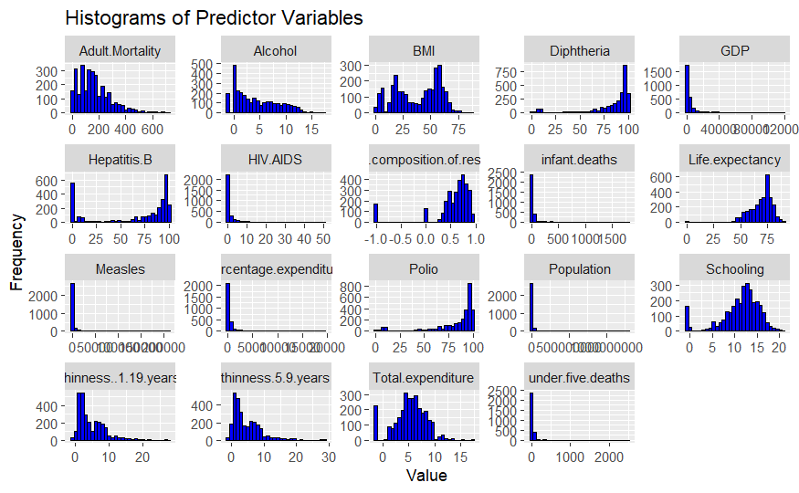
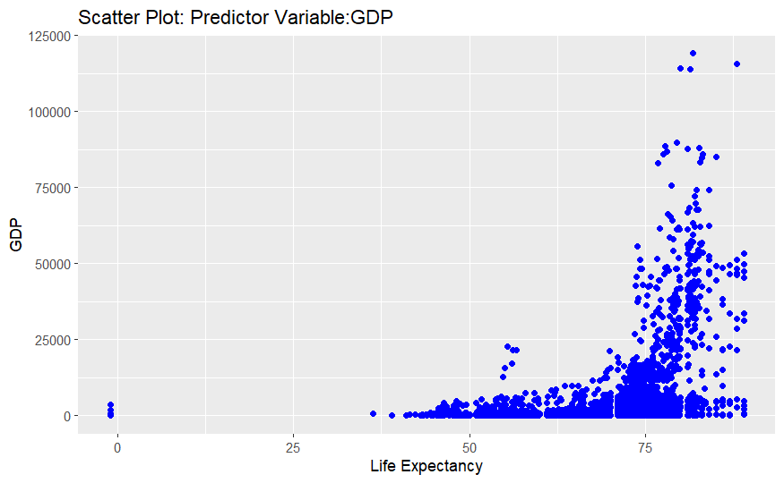
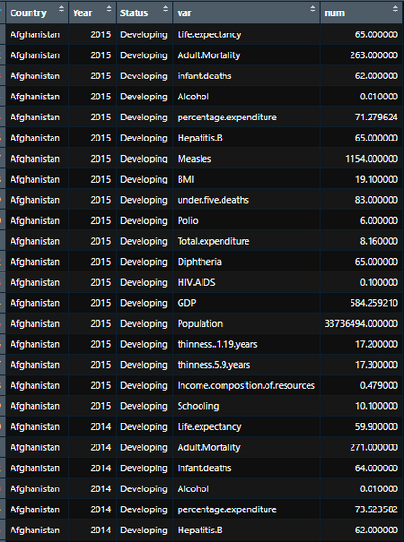
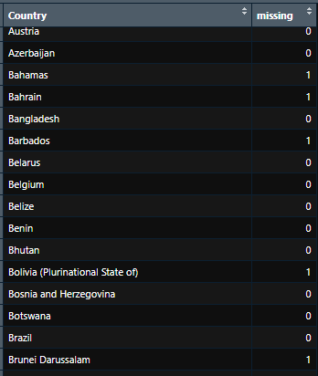
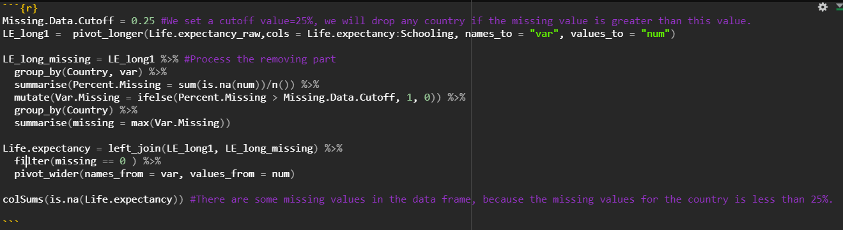
Pivot Long
Missing

Slide 10

Data Cleaning and Wrangling
2. Remove infeasible Columns
Identified and removed duplicated columns.
Kept 'infant.death' over 'under.five.death' due to identical data.
Chose 'thinness..1.19.year' over 'thinness..5.19.years' for broader coverage.
3. Data Type Modifications and addition of new column
Added a new column grouping 193 countries into continents.
Focused on regional life expectancy analysis.
Treated 'Year' as both numerical and categorical.
Created dummy variables for different time periods (e.g., y1, y2, y3).
Categorized 'Alcohol' variable into low, medium, and high consumption levels.
Aimed to analyze the impact of consumption levels on life expectancy.
1. Missing Value modification
2. Infeasible Column Removal
2.Adding new categrory columnl

Slide 11
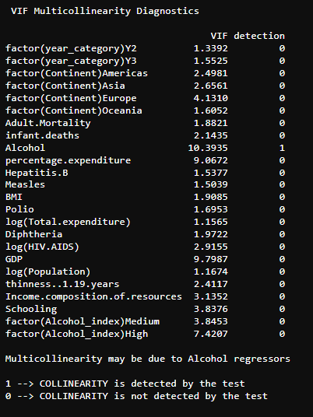
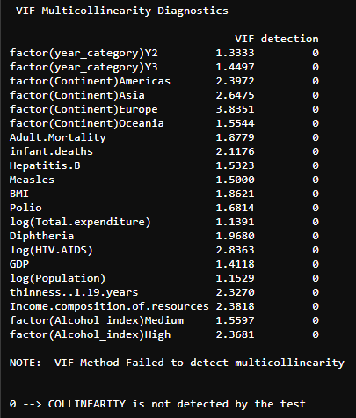
Variable Transformation
Multicollinearity
Dropping variables due to high multicollinearity:
Alcohol, percentage.expenditure,
schooling
Population -> Log(Population)
Total Expenditure -> Log(Total Expenditure )
HIV.AIDS -> Log(HIV.AIDS)
Before
After

Slide 12
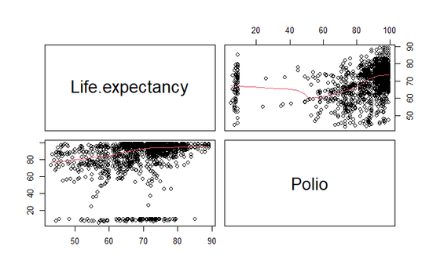
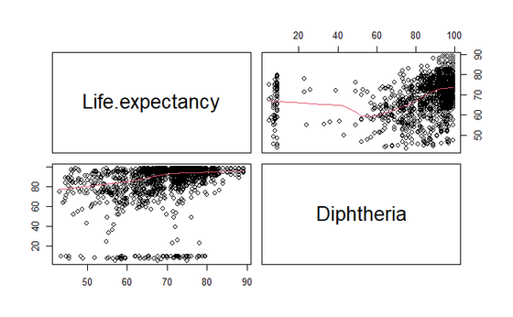
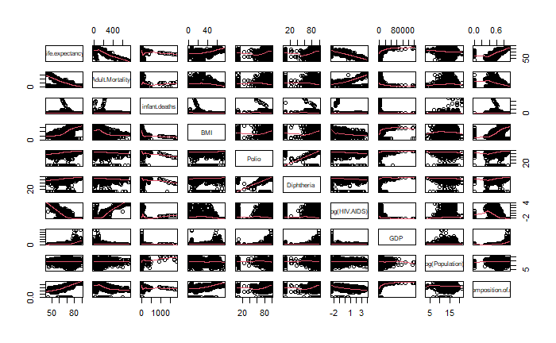
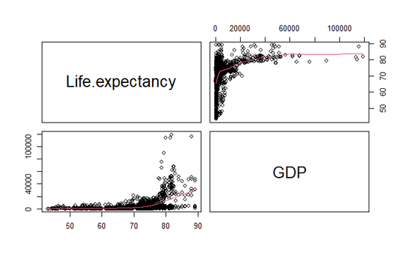
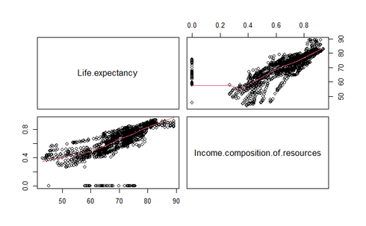
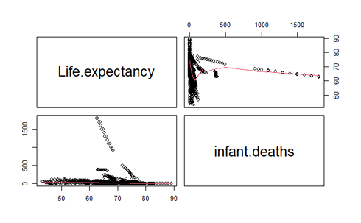
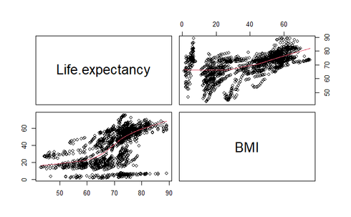
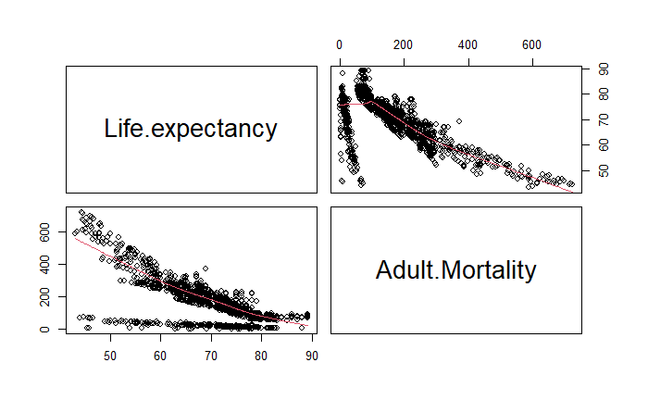
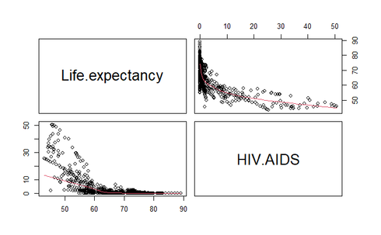
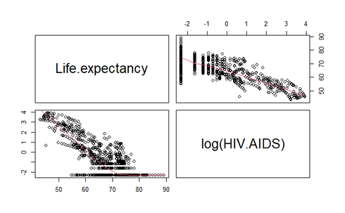
Paris plot

Slide 13
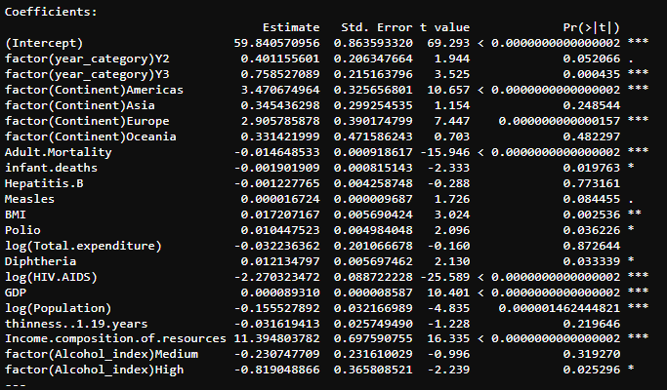
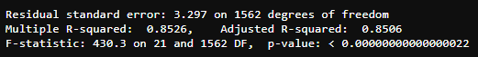
Starting model
fullmodel_factor=lm(Life.expectancy~factor(year_category)+factor(Continent)+Adult.Mortality+infant.deaths+Hepatitis.B+Measles+BMI+Polio+log(Total.expenditure)+Diphtheria+log(HIV.AIDS)+GDP+log(Population)+thinness..1.19.years+Income.composition.of.resources+factor(Alcohol_index), data=Life.expectancy)
Notes:
2 factors
15 number variables
Our starting model is a bit large

Slide 14

Model Selection Procedure
1
1
1
1
Bayesian Information Criterion (BIC)
Bayesian Information Criterion (BIC)
Individual T
Stepwise
Interaction Model
Higher Order Model
Notes:
This is our model selection procedure
Step one is to choose 1 model from... 1 from s.., and 2 from bic.
And use that 1 final main effect model to process interaction and hi order model

Slide 15
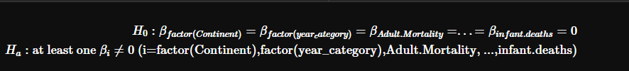
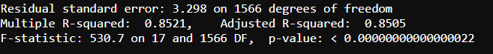
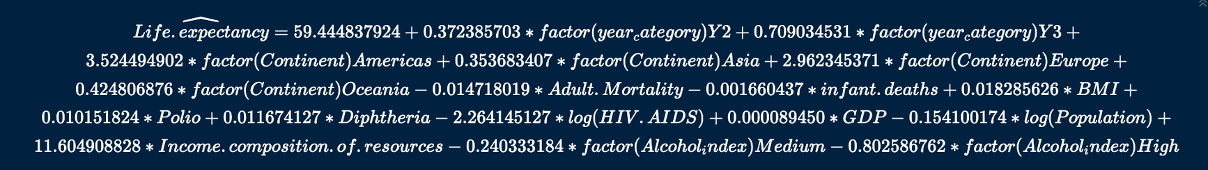
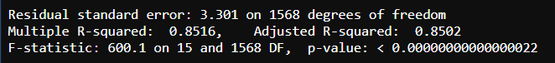
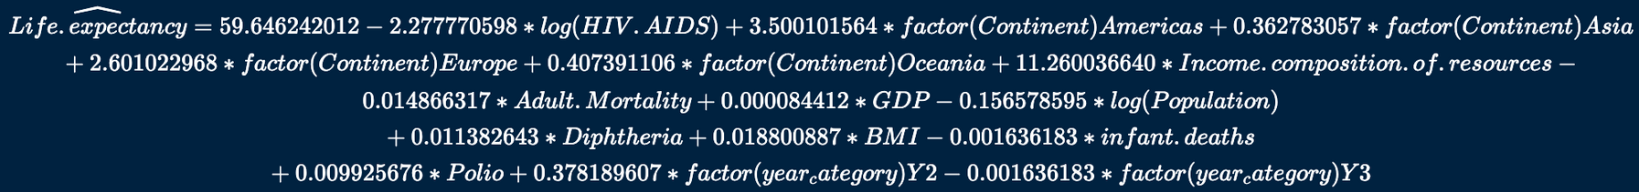
Model Result
Reduced Model: Adj R-square: 85.05%
Significant level 0.05
StepWise Model: Adj R-square: 85.02%
Significant level: 0.05 to 0.1
Notes:
reduced model and
best model from stepwise
R square are pretty close around 0.85

Slide 16
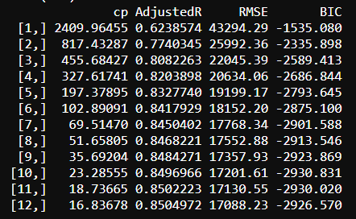
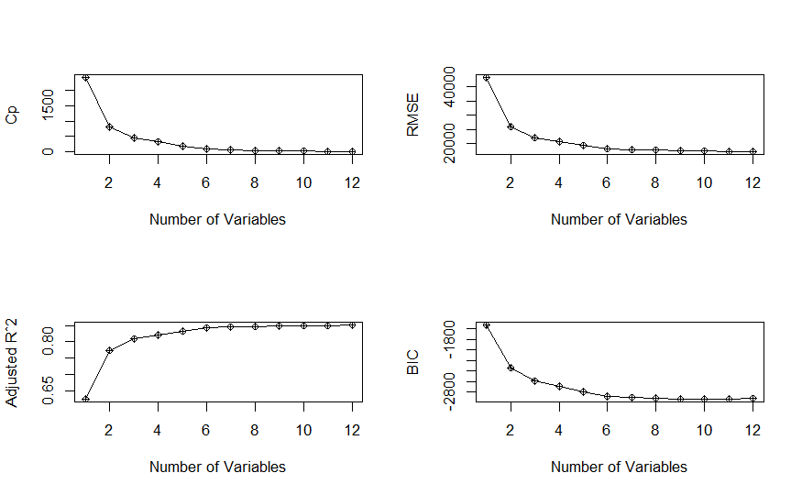

BIC Model
#10: Lowest BIC
#12: Lowest RMSE
Notes:
there is the smallest bic
smallest mean sqaure error/ rmse

Slide 17
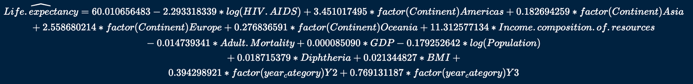
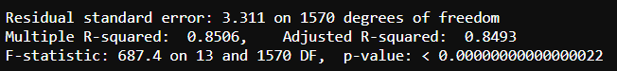
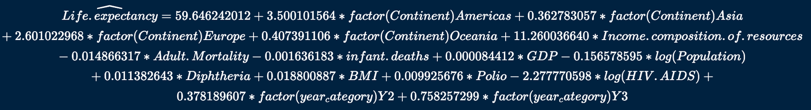
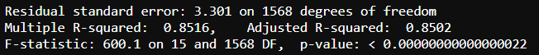
BIC Model
BIC.lm1
Adjusted R-square: 84.93%
P= 0.00000000000000022
BIC.lm2
Adjusted R-square: 85.02%
P= 0.00000000000000022
Notes:
these are the results from those 2 bic models, r square are still pretty close, same around 0.85

Slide 18
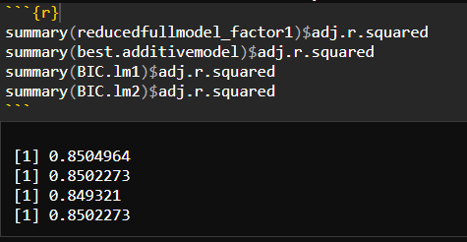
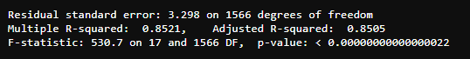

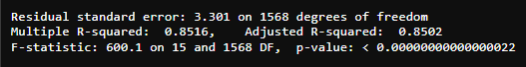
Main Effect Model Selection
Choose one best model from 4 different models to do further interaction higher order model. Measure Adj R2, RMSE, F value and number of variables to determine which is the best main effect model.
Reduced model. 85.04964
BIC #12 model ( less 2 variables) 85.02273
Final main effect model=Life.expectancy~factor(year_category)+factor(Continent)+Adult.Mortality+infant.deaths+ BMI+Polio+Diphtheria+log(HIV.AIDS)+GDP+ log(Population)+Income.composition.of.resources,data=Life.expectancy)
Notes:
R square
residuals are pretty close around 3.3
but bic model #12 has smaller number of variables
This is our final main effect down model.
Now the model size down to 2 factors and 9 number variables

Slide 19
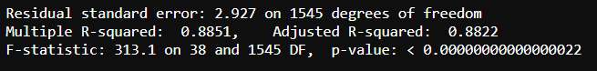

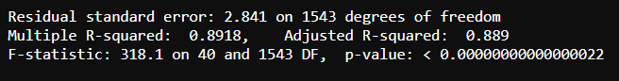
Interaction Model
Interction_model= lm(Life.expectancy~(factor(year_category)+factor(Continent)+Adult.Mortality+infant.deaths+ BMI+Polio+Diphtheria+log(HIV.AIDS)+GDP+ log(Population)+Income.composition.of.resources)^2,data=Life.expectancy)
Adjusted R-square: 88.22%
P= 0.00000000000000022
Higher Order Model Final Model of Year(categorical)
Higher_order_lm=lm(Life.expectancy~I(Adult.Mortality^2)+factor(year_category)+factor(Continent)+Adult.Mortality+infant.deaths+ BMI+Polio+Diphtheria+log(HIV.AIDS)+GDP+ log(Population)+Income.composition.of.resources+factor(Continent):Adult.Mortality+ factor(Continent):infant.deaths +factor(Continent):BMI+ factor(Continent):log(HIV.AIDS)+ factor(Continent):Income.composition.of.resources + Adult.Mortality:infant.deaths+ infant.deaths:Income.composition.of.resources+ BMI:Diphtheria+GDP:log(Population),data=Life.expectancy)
Adjusted R-square: 88.9%
P= 0.00000000000000022
Notes:
next we use that final model to process interaction model and Hi order model
This is the final model of year as factor, rsquare is .889.
This is the final model of year as number, rsquare is .8896

Slide 20
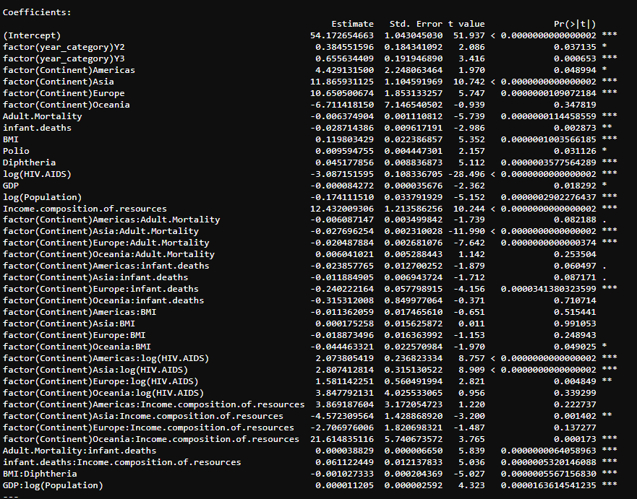
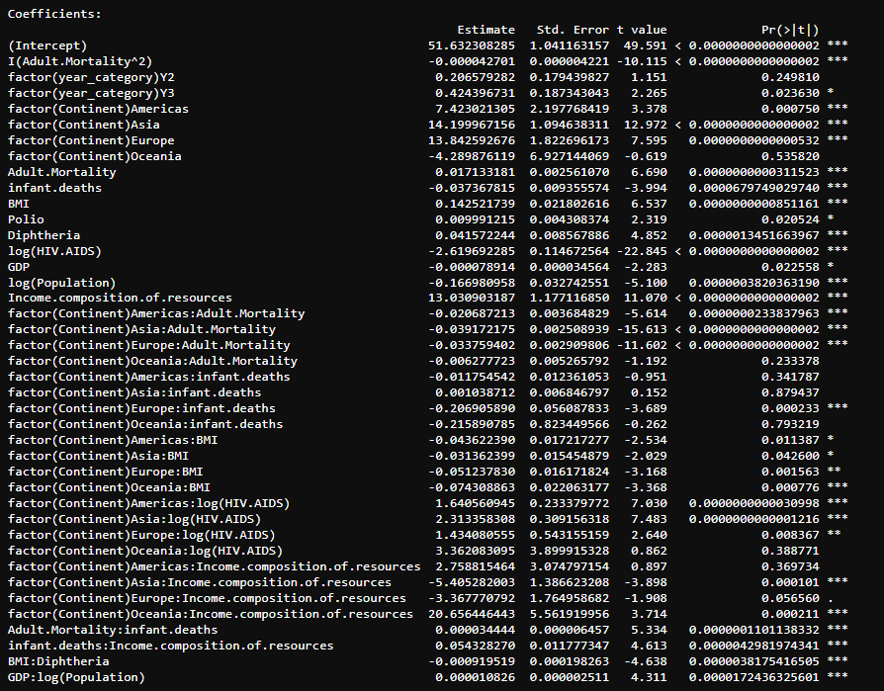
Coefficients for the Interaction Model
Coefficients for the High-Order Model
The best model of Year( cateogry) before assumption adjustment

Slide 21
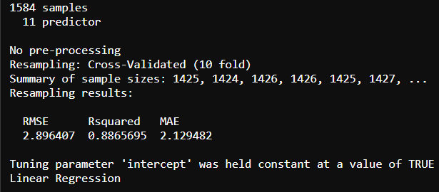
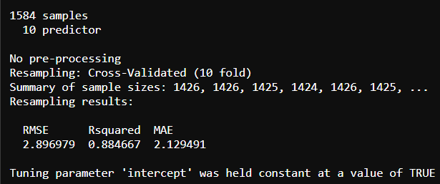
Cross Validation
Final higher order model of Year (Numerical) VS Final higher order model of Year (Categorical )
Rsquare= 0.8896
Rsquare= 0.889
Year (Categorical )
Year (Numerical )
k-fold
K=10
Mean Square Error: 2.896407
Rsquared:0.8866
Mean Absolute Error:2.129482
Mean Square Error: 2.896979
Rsquared:0.8847
Mean Absolute Error:2.129491
Notes:
Way back to the very beginninig, we have 2 models,
Two final models at the very end, we need to choose one final model from those two.
so we use cross validation to measure those two models
fold number is 10
still, The result are still pretty close
but,
The R square of the model year as factor is slightly greater than the model year as number, this is one measurement of final model selection.
next
I will pass to rokaya to go over assumptions.

Slide 22
Regression Diagnostics: Assumptions
1
2
3
Linearity
Independence
Normality
Residuals
vs
fitted values plot
Histogram of residuals
Normal Q-Q plot
Shapiro-Wilk test
4
5
Equal Variance
Influential Points
and Outliers
scale-location plot
Breusch-Pagan test
Residuals vs Leverage
plot
Cook’s Distance
Leverage points
Notes:
The next step in our multiple regression analysis is the regression diagnostics
-here we check if the models satisfy the assumptions of:
-Linearity
-Independence
-Normality
-Equal variance
-Influential points and outliers
-Model with year as categorical variable and
-Model with year as numerical variable)

Slide 23
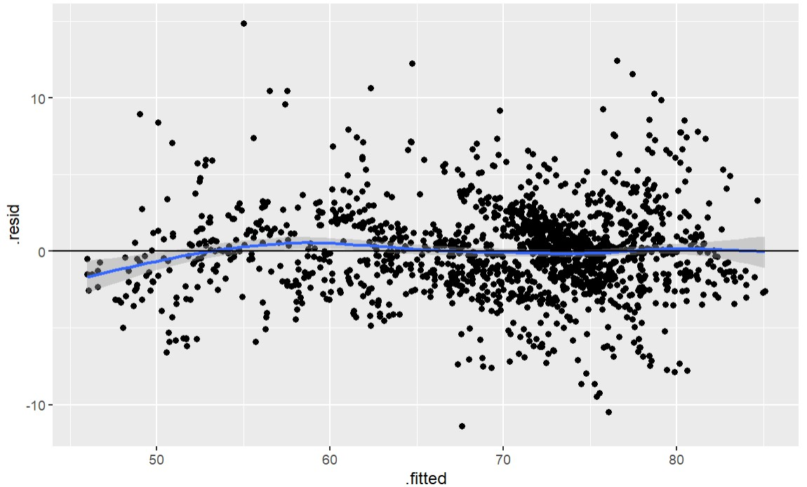
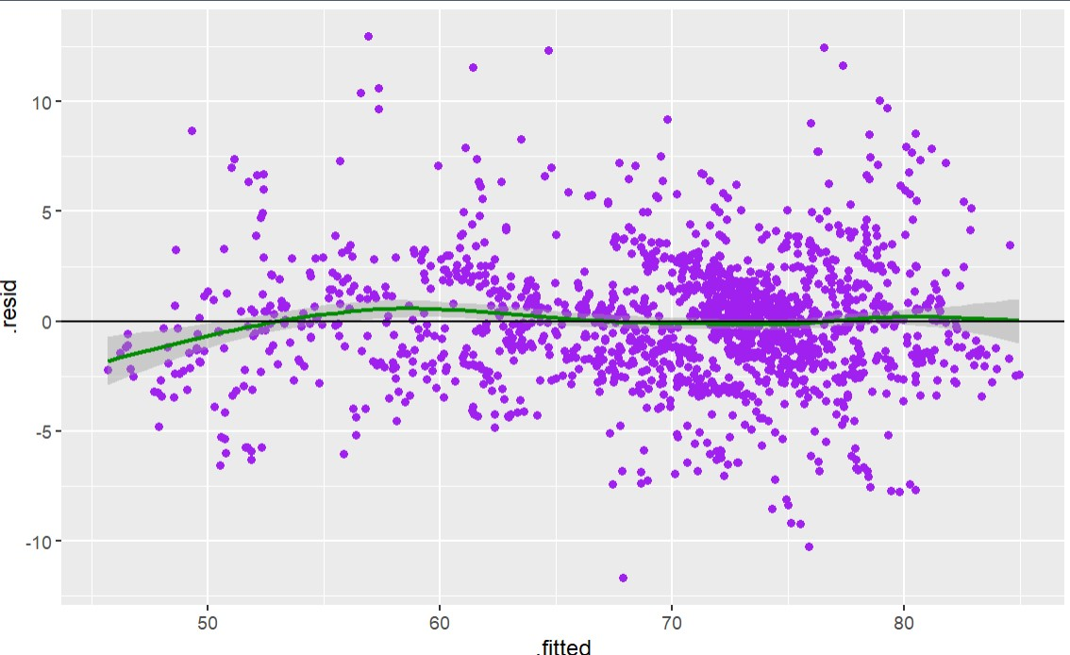
Linearity assumption
Model with Year(categorical)
Model with Year(Numerical)
For both plots,, we observe that the pattern is approximately linear, so we conclude that linearity assumption is met for both models.
Independence Assumption
Independence means that the residuals (errors) of the model are not correlated. And since our data was not directly related to time, we can conclude that independence assumption holds for the models.
Notes:
-Plot of residuals vs fitted values
-For both plots, we observe that the pattern is fairly linear
-So we conclude that linearity assumptions hold for both models

Slide 24
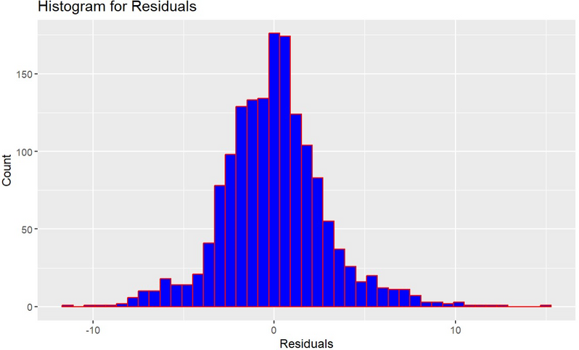
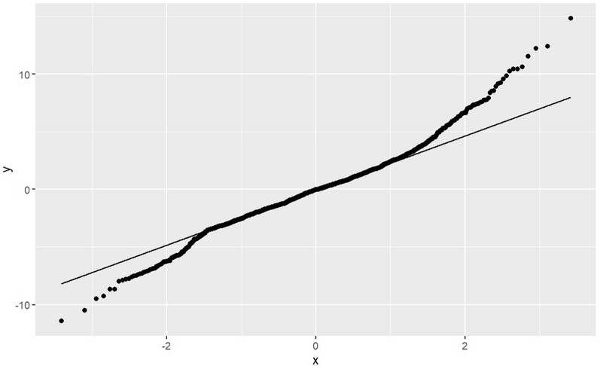
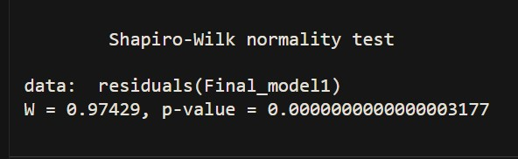
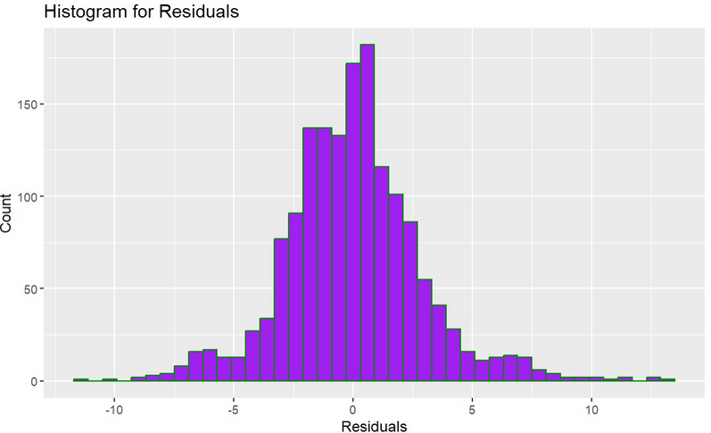
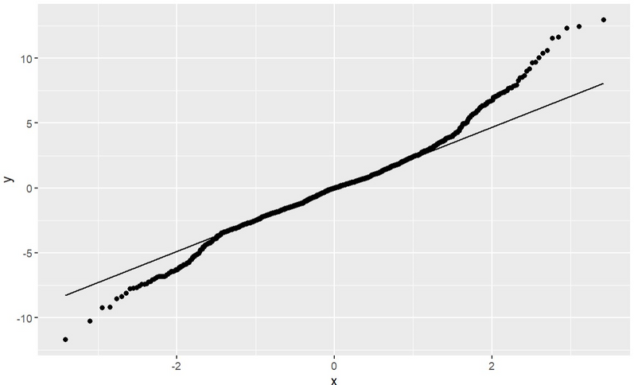

Normality Assumption
H0 : the sample data are significantly normally distributed
Ha : the sample data are not significantly normally distributed
Year(categorical)
Shapiro-Wilk Test
Your paragraph text
P-value = 0.0000000000000003177
The P-value is approximately 0 which is less than the significant level of $\alpha$=0.05, therefore we reject the null hypothesis and conclude that residuals of the sample data are not significantly normally distributed.
Year(numerical)
Shapiro-Wilk Test
P-value = 0.0000000000000003492
Notes:
-Normality assumption
-assumes the residuals of the model are normally distributed
1) Histogram of residuals
2) Normal Q-Q plot
3) Shapiro-Wilk test
-Test hypothesis:
Ho
Ha
-hist: not exactly normal
-q-q plot: we notice that the points on the plot deviate slightly from the diagonal line at the tail ends
-shap-Wlk: P-value is apprx 0 < significant level of 0.05
- we reject the null hypothesis and conclude that
- the sample data are not significantly normally distributed

Slide 25




Equal Variance Assumption (Homoscedasticity)
Breusch-Pagan test
Breusch-Pagan test
H0 : heteroscedasticity is not present (homoscedasticity)
Ha : heteroscedasticity is present
The p value is 0.00000000000000022 which is less than 0.05 so we reject the null hypothesis and conclude that heteroscedasticity is present.
Notes:
-some pattern observed in the scale-location plot
-bp-test
Ho: homoscedasticity present
Ha:heteroscedasticity present
-P-value is very small
-Reject Ho
-Heteroscedasticity present

Slide 26





Box-Cox Transformations
bestlambda
Year(categorical)
Box-cox Model 1
Adjusted R-squared: 0.8817
bestlambda
Year(numerical)
Box-cox Model 2
Adjusted R-squared: 0.8822
Notes:
*summarize*
We carry out a box_cox transformation to correct non-normality and heteroscedasticity;
Actions
Box-Cox Transformations (Transformations for Nonnormallity and Heteroscedasticity)
This is supposed to help the data have equal variance and also make the transformed data to follow a normal distribution.
-plot of log-likelihood vs lambda
-calculate best lambda
-fit the box-cox transformed model

Slide 27




Running checks on the box-coc models
From the output, the P-value is also approximately 0 which is less than the significant level of $\alpha$=0.05, therefore we reject the null hypothesis and conclude that residuals of the sample data are not significantly normally distributed.
However, for large sample sizes, the Central Limit Theorem comes into play. It states that, as the sample size increases, the sampling distribution of the regression coefficients tends to be normally distributed, regardless of the distribution of the residuals. This means that the estimations of coefficients and their standard errors remain reliable even if the residuals are not perfectly normally distributed. Therefore we can conclude that normality assumption for both models holds.
The p-value remains unchanged for both models, indicating that heteroscedasticity persists. Consequently, we opt to retain the original final models.
Notes:
To check for improvement, we re-run the bp-test for homoscedasticity and shapiro-wilk normality test on the boxcox-transformed models.
-p-value still < 0.05 so we retain former model
- For large sample sizes, Central limit theorem, so we can conclude that the models meet the normality assumptions
-since we have a large sample size,the dist of reg coeffs tends to be normally dist
-normality assmp is met

Slide 28






Outliers and Influential points
Year(categorical)
Year(numerical)
we have noticed some high leverage/influential points in our dataset which may have occured due to an error in data collection. Hence, these observations will be removed from our model.
Leverage value:
hi >2p/n or 3p/n
Notes:
1) Residuals vs Leverage plot and 2) Cook’s Distance where there are no visible outliers
3) Leverage points
- Calculate leverage values
-remove high-leverage data points
-we have noticed some high leverage/influential points in our dataset
- may have occured due to an error in data collection.
-these observations will be removed from our model.

Slide 29












We Fit the model with cleaned data and adult.mortality as a higher-order term to further improve the model leading to a slight increase adjusted R2 value(0.9025 ) for the model factor(year).
Re-checking the Assumptions
Year(categorical)
Year(numerical)
Linearity Check
Normality Check
Linearity Check
Normality Check
Normality Check
Normality Check
Homoscedasticity Check
Homoscedasticity Check
Notes:
-Next, to further improve the model
-after removing the influential points
- we decided re-run our model with the cleaned data
-using adult.mortality as a higher-order term for both model
the assumptions for mulitiple regression hold for both models except *equal variance assumption
- note that normality assumption holds regardless based on the central limit theorem

Slide 30


Conclusion
Predicy
From Model performance
Final model of Year (Categorical )
Final model of Year (Numerical) )
Adjusted R-square: 90.25%
Adjusted R-square: 88.96%
Mean Square Error: 2.896407
Rsquared:0.8866
Mean Absolute Error:2.129482
Mean Square Error: 2.896979
Rsquared:0.8847
Mean Absolute Error:2.129491
2.From Assumptions
Both models satisfied the assumptions checks except for the equal variance assumption. However the model with Year as categorical variable had a more linear pattern than the model with Year as numerical variable.
Based on these 2 criteria:
Higher order model with Year as categorical (Dummy) variable is our chosen final model
Notes:
In conclussion, the model with year as dummy variable had an adj r2 of 90.25% which is higher than that of the model with year as numerical varble

Slide 31

Final Fitted Model
The best fit model for predicting life expectancy:
Notes:
response variable Y is fitted with the best predictors

Slide 32

Fitted Model with Coefficients

Slide 33




Prediction
Predicy
Adult.Mortality=200 deaths per 1000 population, year_category="Y1"(2000-2005),
Continent="Asia", infant.deaths=70 infants death per 1000 population,
Average Body Mass Index of entire population =30,
Polio (Pol3) immunization coverage among 1-year-olds is 30(%) ,
Diphtheria tetanus toxoid and pertussis (DTP3) immunization coverage among 1-year-olds is 80(%),
Deaths per 1000 live births HIV/AIDS (0-4 years) is 0.1,
Gross Domestic Product per capita (in USD) is 4000, Population =9,880,000,
Human Development Index in terms of income composition of resources (index ranging from 0 to 1)= 0.5
You know it's tie when you're comfortable seeking one.
We are 95% confident that Predicted Life Expectancy = 68.7
Notes:
micheal : i feel we should include the unit of life expectancy

Slide 34




Thank you!

Slide 35
References
Ortiz-Ospina, E. (2017, August 28). “Life Expectancy” – What Does This Actually mean? Our World in Data. https://ourworldindata.org/life-expectancy-how-is-it-calculated-and-how-should-it-be-interpreted
Rajarshi, K. (2017).
Life Expectancy (WHO).
Www.kaggle.com. https://www.kaggle.com/datasets/kumarajarshi/life-expectancy-who/data

